Slide 1


YOUR QUALITY PARTNER FOR SOFTWARE SOLUTIONS
5G Overview
Sierra Wireless Validation Team
TMA Solutions
www.tmasolutions.com

Slide 2
Agenda
Introduction
…
…
Conclusion
Reference
Q & A

Slide 3
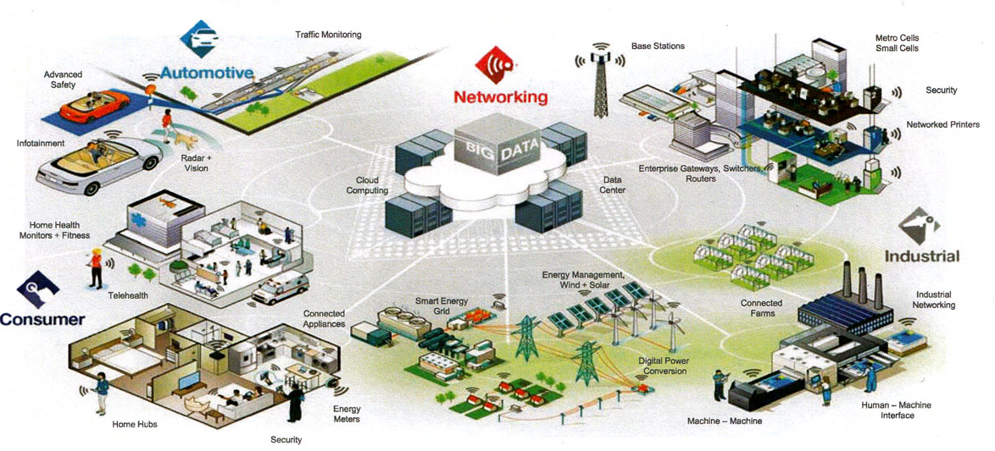
Introduction 5G
Enhanced Mobile Broadband:
Ultra-high-definition, such as 4K and 8K, and 3D video.
Critical Communications
Automotive, including autonomous vehicles, …
Monitoring of critical infrastructure, such as transmission lines, using long battery life and low-latency sensors.
Notes:
Reference: abc.com

Slide 4
Conclusion
…

Slide 5
Reference
…

Slide 6

Q&A

Slide 7

THANK YOU !
Tel:
Mobile:
Fax:
Email:
+84 8 3997-8000
+84 908-676-212
+84 8 3990-3303
sales@tmasolutions.com
North America number:
Australia number:
Japan number:
Website:
+ 1 802-735-1392
+ 61 414-734-277
+81 3-6432-4994
www.tmasolutions.com

